Slide 1

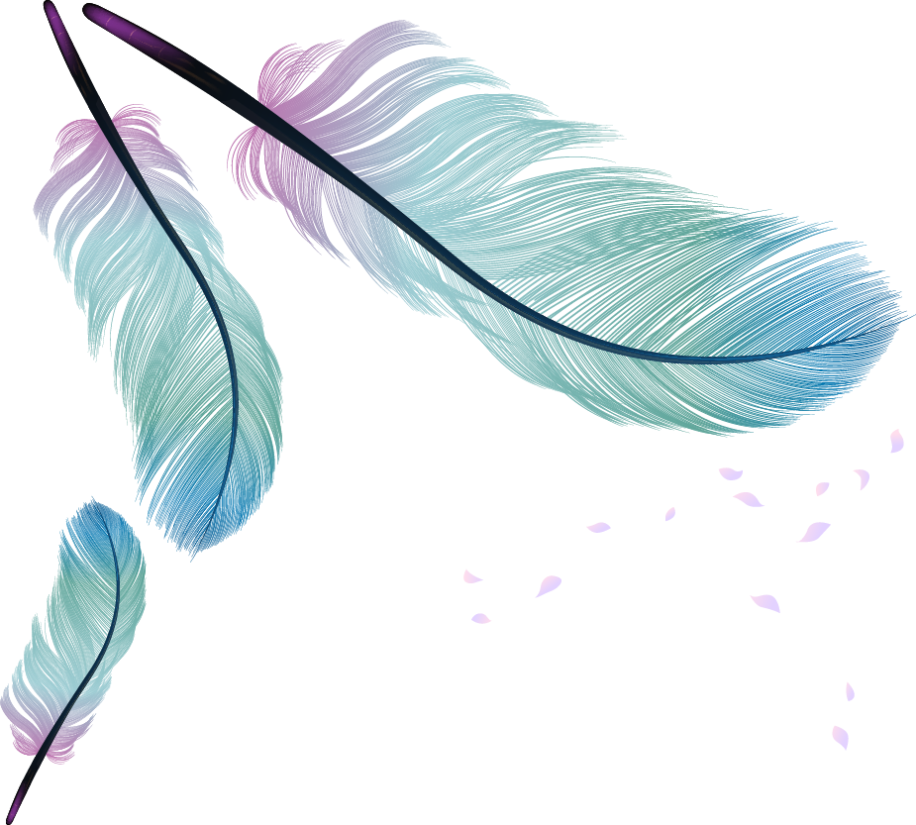

2021年4月 宁波二模读后续写
祖父的手表

Slide 2
The watch was my grandfather’s. He hung it by his bed. The face was marked with elegant Roman numbers and the case was gold. My grandfather got it after his fifty years of faithful service with his firm. I often gazed at it longingly as I sat with my grandfather after school.
The day I told him of my success in the examinations, he was pleased, “ You’ll be going to the new school next, Will. Remember you’ll need plenty of patience. That’s the right way.” I nodded when handing him the watch. He gazed at it for some moments, and wound it.
my grandfather’s watch and my eagerness for it.

Slide 3
The next morning my mother told me he had died in his sleep and left me his watch. For safety, my mother was to put it away in trust until she considered me old enough to look after it. I protested(抗议) so strongly that she finally agreed to hang it in the kitchen where I could always see it.
My mother put away the watch, allowing me to admire it.

Slide 4
The summer soon ended and it was time for me to enter the new school. I never made friends easily, and for a time I did little more than get on speaking terms with some boys. One of them was a rich fellow whose way of impressing us was to parade his possessions before us. Everything Crawley had was better than ours – until he brought the watch.
I entered the new school and met new classmates
and new problems.

Slide 5
“I have a better watch than that, ” I announced, attempting to impress them. “Well, show it to us, ” Crawley sneered (冷笑) in disbelief. Embarrassed, I promised to bring it to them that afternoon.
Considering there was no way to persuade my mother to let me take the watch, I decided to wait for her to step outside and slip the watch into my pocket. So I did. After lunch, as I was too excited to wait for the return bus, I got my bike out of the shed.
I rode fast, excitement coursing through me. Then suddenly a puppy ran out into my path. I pulled at my brakes so hard that the bike stopped to a sharp standstill (急停) and I fell over.
I wanted to impress the boys with my grandfather’s watch,
so I stole it without mom’s permission
an accident on the way

Slide 6
形容词副词梳理 “I”情感
gazed at it longingly as I sat with my grandfather after school
I protested(抗议) so strongly
I never made friends easily
Embarrassed, I promised to bring it to them that afternoon
I was too excited to wait for the return bus
I picked myself up and put a trembling hand into my pocket
Long to have the watch
I valued the watch
I was eager to make friends
I was embarrassed to be sneered at.
I was excited/eager/couldn’t wait to show off my watch.
I was afraid.

Slide 7
两段之间的衔接及主题
Paragraph 2
“That’s not the right way. Patience, Will. Patience, ” a voice echoed in my ears after the boys left.
What way is not the right way?
my way(show off) to please/impress the boys/make friends/
attempt to integrate into the new school/circle)
hurriedly.

Slide 8
前文基于主题的有效信息：
The day I told him of my success in the examinations, he was pleased, “ You’ll be going to the new school next, Will. Remember you’ll need plenty of patience. That’s the right way.”
The summer soon ended and it was time for me to enter the new school. I never made friends easily, and for a time I did little more than get on speaking terms with some boys.
“You'll needs patience” means?
It takes me patience to make new true friends
/adjust to the new surroundings.

Slide 9
文章的主题
“ You’ll be going to the new school next, Will. Remember you’ll need plenty of patience. That’s the right way.”
Patience is the key.
“That’s not the right way. Patience, Will. Patience, ”
One of them was a rich fellow whose way of impressing us was to parade (show off) his possessions before us.
How to develop friendship
“I have a better watch than that, ” I announced, attempting to impress them

Slide 10
两段之间的衔接及主题
Paragraph 2
“That’s not the right way. Patience, Will. Patience, ” a voice echoed in my ears after the boys left.
The boys must come , see the situation and say or do something disgusting to me before they left, leaving me depressed or helpless.
在第二段时开始时， the boys 已经离开了

Slide 11
However， instead of scolding me and punishing me, mom just asked me send the watch to a repair shop. And she said that I was qualified to look after it, due to my patience and honesty. (zhang)

Slide 12
结尾：
呼应前文，解决冲突（炫耀，偷表）
主题提升：Patience is the best policy. Grandfather’s words will act as a reminder whenever I lose patiene for the rest of my life.

Slide 13
答案范文
“That’s not the right way. Patience, Will. Patience,” a voice echoed in my ears after the boys left. Though anger, embarrassment and sadness hung heavily in the air, the voice drew me to the awareness of the mistakes I had made when I attempted to impress the boys. I shouldn’t have tried to integrate in such a hasty way, nor should I have stolen the watch behind my mother to show off. It was the first time that I had truly realized the meaning of the gift --- patience. I knew for sure that every time I lost patience in the future I would remember my grandfather’s words.

Slide 14
Staring at the cherished watch, I thought grandfather was right. My anger gave way to patience. That afternoon when I got speaking terms with the boys, I told the faithful service of my grandfather behind the watch. This time, no laughter, no contempt but respect.Even Crawley drooped his head and stammered an apology to me, promising to help me fix the watch. As the orange sun cast down on my face, I rode back home, wearing well-repaired watch. It's the first time I've known the power of patience and it would keep me company for the rest of my life. (yao)

Slide 15
对衔接句子的自问自答梳理续写思路
Paragraph 1
I picked myself up and put a trembling hand into my pocket.
1. What did I find when I reached the pocket?
with watch or no watch?
2. If I couldn’t find the watch in the pocket, where could I find?
On the road or near the bike?
3. What happened to the watch?
Nothing wrong or broken?
4. How did I feel and think?
desperate/hopeless/regretful

Slide 16
I fumbled (combed) every corner of my pocket, my heart plummeted.“It must tumble to the ground in that collision.”I assured myself. As if clinging the last straw, I hastily searched nearby, but in vain. It didn't take several munutes before I surrendered and rode to school, brainstorming how to convince them of the missing watch.At the afternoon, I stammered out the experience with face flushing scarlet, which was responded by ridicules. “You'd better practice how to lie.” Crawley sneered in disbelief. How I wish the watch could suddenly appear in my pocket. (zhou)

Slide 17
Suddenly, an annoyed laughter came from behind... Overwhelmed by anger, I jumped to my feet, roared to them with tears in my eyes... They giggled wildly, shrugged and went away with their belly laughter.(qiu)
From behind came a sudden annoyed laugher ... Overwhelmed by anger, I jumped to my feet, roaring to them with tears in my eyes...They shrugged , exchanged sneering eyes and swaggered off (walked away without a backward glance) with their roaring belly laughter.他们耸耸肩，互看了个轻蔑的眼神，扬长而去

Slide 18
答案范文
I picked myself up and put a trembling hand into my pocket. Then I brought out what was left of my grandfather’s proudest possession. There was deep bulge凸出部分in the watch, the glass shattered, and the Roman numbers looking crazily at one another. Putting it back, I rode slowly on to school, numb with misery. After what seemed forever, I finally turned up before the waiting boys. “My mother wouldn’t let me bring it,” I lied. “His mother wouldn‘t let him,” Crawley jeered嘲笑. “What a story!" The others took up his cries and left without a backward glance.

Slide 19
参考范文
I picked myself up and put a trembling hand into my pocket. Then I brought out what was left of my grandfather’s proudest possession. There was deep bulge凸出部分in the watch, the glass shattered, and the Roman numbers looking crazily at one another. Putting it back, I rode slowly on to school, numb with misery. After what seemed forever, I finally turned up before the waiting boys. “My mother wouldn’t let me bring it,” I lied. “His mother wouldn‘t let him,” Crawley jeered嘲笑. “What a story!" The others took up his cries and left without a backward glance, leaving me annoyed and embarrassed.

Slide 21
续写（句型，词）
1同位语，定语
I found nothing in my pocket, a fact that seemed like a spear piercing into my heart.
在口袋里什么也没找到，这个事实就像一把长矛刺进了我的心。
2. 副词+短语
Anxiously, I almost burst into crying.
我焦急地几乎哭了起来。
Clearly I ruined my deceased grandfather’s possession.
很明显我毁了我已故祖父的财产.

Slide 22
3.名词性从句
Then I brought out what was left of my grandfather's proudest possession.
然后我拿出我祖父最自豪的财产。
After what seemed forever, I finally turned up before the waiting boys
似乎过了很久，我终于出现在等候的孩子们面前

Slide 23
4 外貌、神态描写+非谓语
There was deep bulge in the watch, the glass shattered, and the Roman numbers looking crazily at one another.
手表鼓得很深，玻璃碎了，罗马数字疯狂地互相看着
Putting it back, I rode slowly on to school, numb with misery.
把它放回去，我慢慢地骑车去学校，痛苦得麻木了。

Slide 24
5.对话+伴随/动作/介词短语
“My mother wouldn't let me bring it,” I lied, desperation boiling inside me.
我妈妈不让我带，”我撒谎，绝望在我心中沸腾。
“What a story!" The others took up his cries and left without a backward glance.
“真是个故事！”其他人大声叫嚣，没有回头看一眼就走了。
They laughed loudly with Crawley screaming words like “What a finest broken watch!”
他们大声地笑着，像是在尖叫“多漂亮的破表啊！”

Slide 25
6.环境描写+状语从句
Though anger, embarrassment and sadness hung heavily in the air, the voice drew me to the awareness of the mistakes I had made when I attempted to impress the boys.
尽管愤怒、尴尬和悲伤重重地笼罩在空气中，但这个声音还是让我意识到我在试图给同学留下深刻印象时犯下的错误。

Slide 26
7.倒装
I shouldn’t have tried to integrate in such a hasty way, nor should I have stolen the watch behind my mother.
我不该如此匆忙的方式试图融入，也不该把母亲身后的手表偷走。

Slide 27
8 时间状语
However, from then on I promised that this broken watch would always remind me to be patient until truth emerged itself.
然而，从那时起，我保证这只破表会一直提醒我耐心等待，直到真相出现。
I knew for sure that every time I lost patience in the future I would remember my grandfather’s words.
我确信，将来每当我失去耐心时，我都会记住祖父的话。

Slide 28
9 无灵主语+情绪
Embarrassment enveloped me totally.
尴尬把我完全包围了。
Lump was stuck in my throat.
肿块卡在我的喉咙里（说不出话来）。
Sadness hang heavily in the air.
悲伤弥漫在空中。

Slide 29
“That’s not the right way. Patience, Will. Patience,” a voice echoed in my ears after the boys left. Grandfather was right! I wiped away my tears, and wrapped my precious watch with a piece of paper and then put it into my school bag. “What was done was done,” thought I to myself. “What is important now is to do correct things next.” After school, I would tell my mother honestly that I had stolen the watch out to impress friends who turned out not to be my true friends. I would admit that I had forget the last advice that grandfather gave me. However, from then on I promised that this broken watch would always remind me to be patient until truth emerged itself.

Slide 30
I picked myself up and put a trembling hand into my pocket. Empty! I found nothing in my pocket, a fact that seemed like a spear piercing into my heart which started to bleed immediately. Looking around anxiously, I almost burst into crying. Just near my lying bike, the golden case of the watch was forced open. Clearly I ruined my deceased已故的 grandfather’s possession. I cautiously put the whole thing on my both palms to inspect the damage. The glass of the watch was cracked into several pieces and some Roman numbers were displaced from its face. Just at the time I broke down, a group of boys led by Crawley passed me. They laughed loudly with Crawley screaming words like “What a finest broken watch!”

